Slide 1
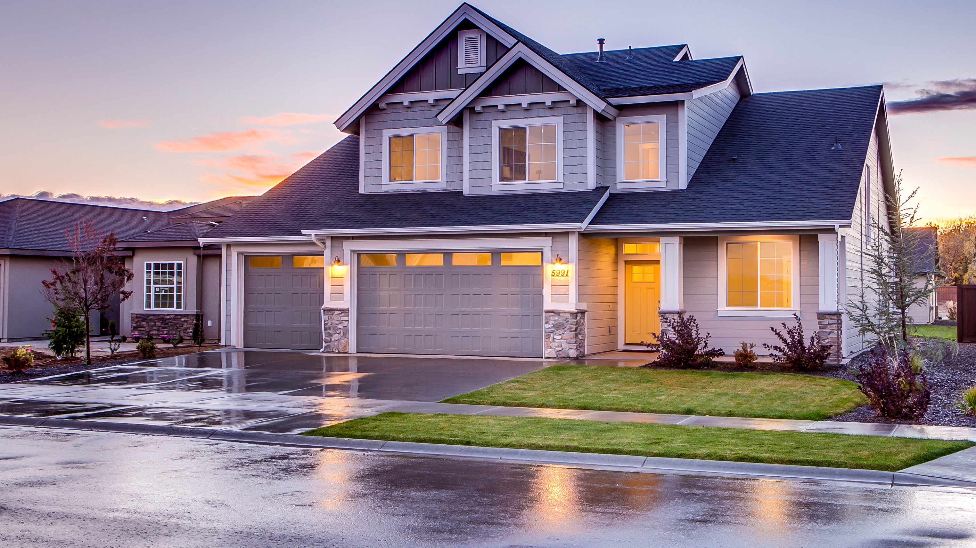
Predicting House Prices in Ames
Roy Kim

Slide 2
Background Information
Ames is a city in central Iowa, just north of Des Moines
In 2017, population of about 66,000
Home of the Iowa State University, other USDA sites
Ranked 9th in CNNMoney’s “Best Places” to Live in 2010
Notes:
Approximately half of Aimes’ population is student body of ISU
Largest federal animal disease center in US

Slide 3
Goal
Determine what features are most important in predicting the price of a house in the Ames market.
Develop a model that accurately predicts house prices.
Problem Statement
Can we make more accurate house price estimates to benefit our clients and maximize profit?
Notes:
One of the struggles of buying and selling houses is having an accurate prediction of the price!
As a recent house seller, I can tell you the pain of that struggle!

Slide 4
Approach
Import Ames Housing data
Clean the data (mostly resolving null values)
Analyze data to have a basic idea of important features
Create a highly accurate model to predict sale price
Analyze model to see what the most important features are, and present findings

Slide 5
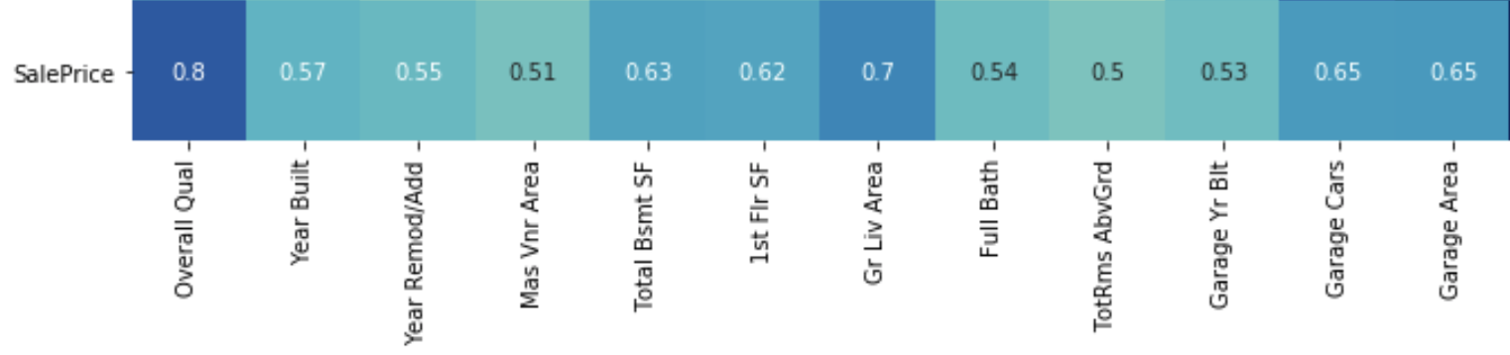
Step 1 Findings / Supporting Information
Features that are highly correlated to ‘SalePrice’
Characteristics of houses that will likely increase the value of the house
Notes:
Mas Vnr Area = Masonry veneer area in square feet
Gr Liv Area = Above grade (ground) living area square feet
TotRms AbvGrd = Total rooms above grade (does not include bathrooms)

Slide 6
Notes:
Along with the square footage of the house and the basement,
Modernity
Number of rooms
Bathrooms
Garage size
Masonry veneer (outer masonry work to improve attractiveness and command higher price!)

Slide 7
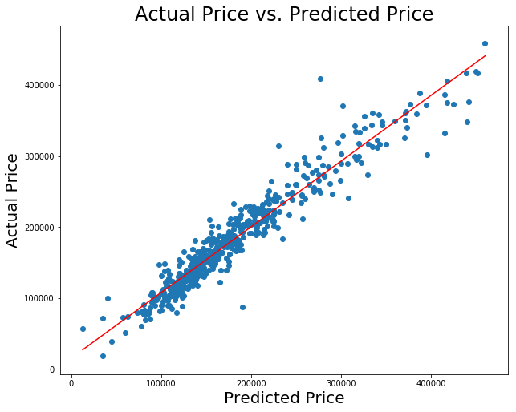
Step 2 Findings / Supporting Information
R2 = 0.926
RMSE = 21300
Notes:
R2 – 92% of the variability in the actual price can be explained by the predicted price
RMSE – On average, we can expect predictions to be off about $21,300, which is within a 10% range of $200,000

Slide 8
Conclusion
Yes! Accurate house price predictions are possible!
Notes:
With a more accurate prediction of price, there can be less haggle, more transparency, and more business!

Slide 9
Recommended Actions
Keep in mind important features that increase the value of a house when meeting potential buyers/sellers
Use model to more accurately predict prices

Slide 10
Next Steps / Questions
Apply model to all house valuations in Ames with real estate company
Continue to strengthen partnership between realtor team and data team to expand profits

